Slide 1
SUMMER CAMP DATABASE
Ignacio Sanz, Lucía Arce, Raquel González, Catalina Infantes y María Villalba

Slide 2
Introduction
Summer camp is a camp providing recreational and sporting facilities for children during the summer holiday period.
We choice to do a database that help a summer camp to be more evicient

Slide 3
Explanation of our database
The Camper is our main entity, that can have or not an accomodation or activity. It can also chose to rent a material.
All the activities have an instructor, if they dont it is impossible to take the class

Slide 5
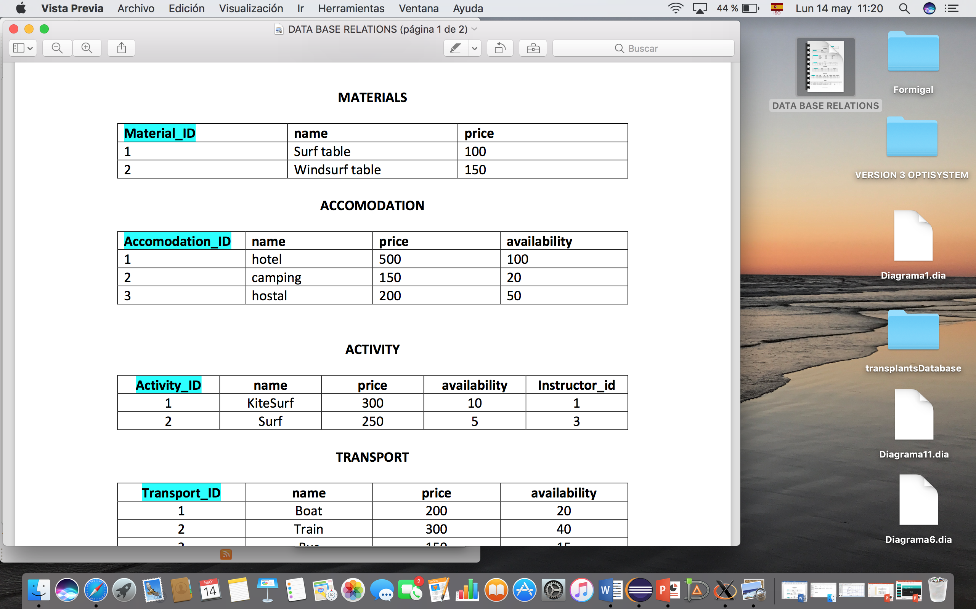
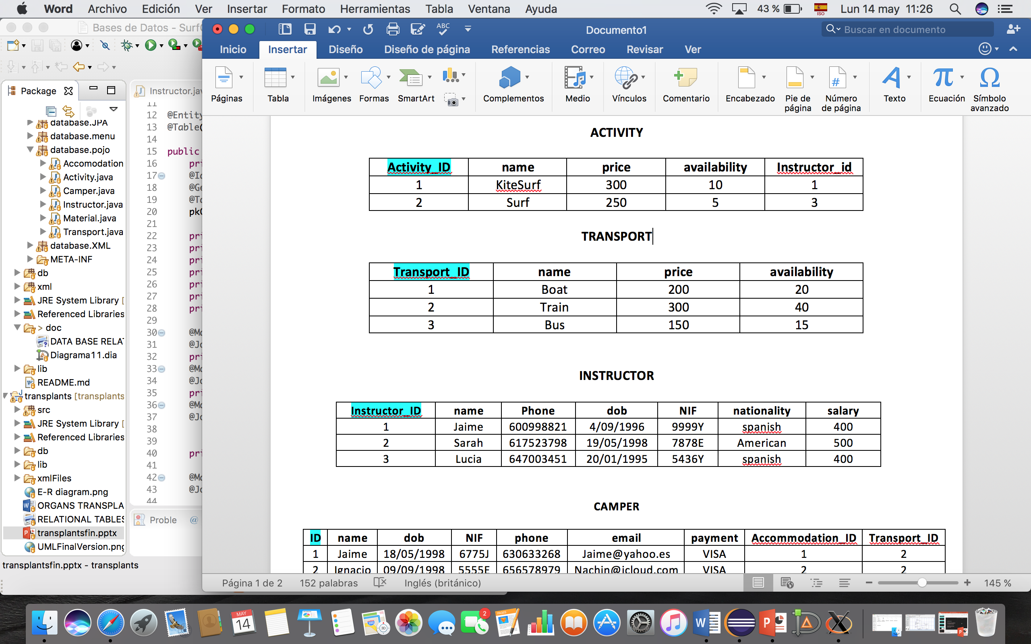
Relational Tables

Slide 6
INSTRUCTOR
The instructor have a relation N to 1 with activity: one instructor can have many activities.
Every activity must have a Instructor, if not the activity cant be taken.

Slide 7
